Slide 1



yyyyyyyy
y
React JS + Redux
July 7, 8, 14, 2018

Slide 2
React, ES6 & Redux
y
yyyyyyyy

Slide 3
Third Application
Voting App
y
yyyyyyyy

Slide 4
Setup:
Open terminal
#copy voting_app project to project folder
#cd voting_app
#npm install
#npm start

Slide 5
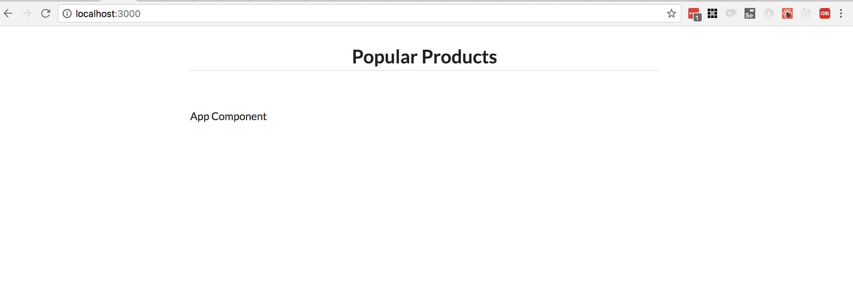
Page:

Slide 6
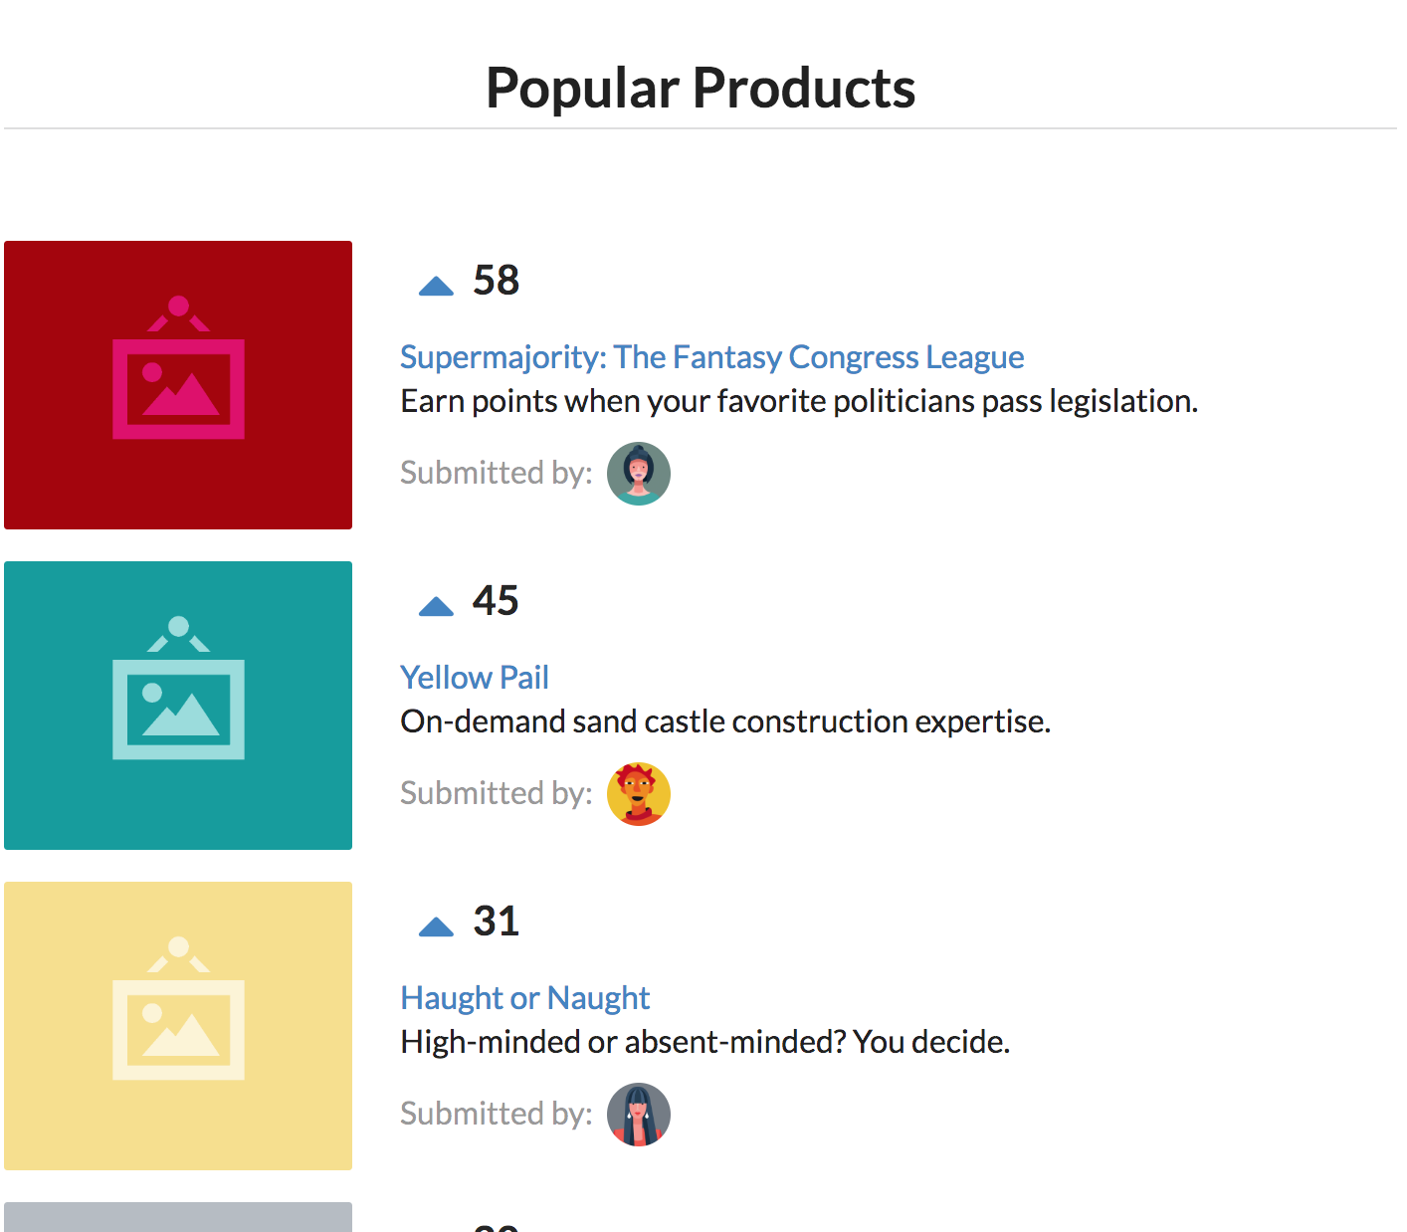
Page:

Slide 7
Review of Components
y
yyyyyyyy

Slide 8
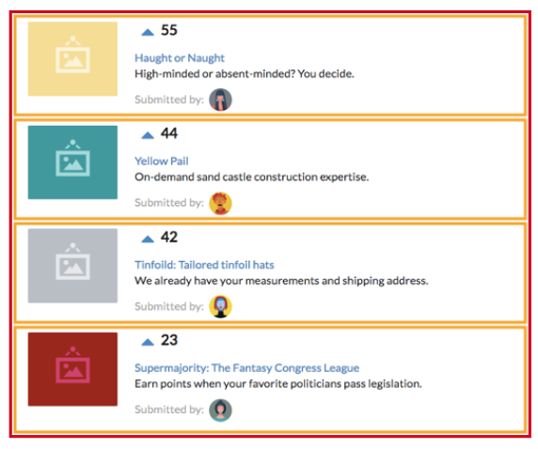
Page:
Product List: Contains all the list of product components
Product: Displays a given product

Slide 9
Create our Components
y
yyyyyyyy

Slide 10
Let’s start building our component:
Let’s start building our ProductList component inside components folder.
ProductList.jsx

Slide 11
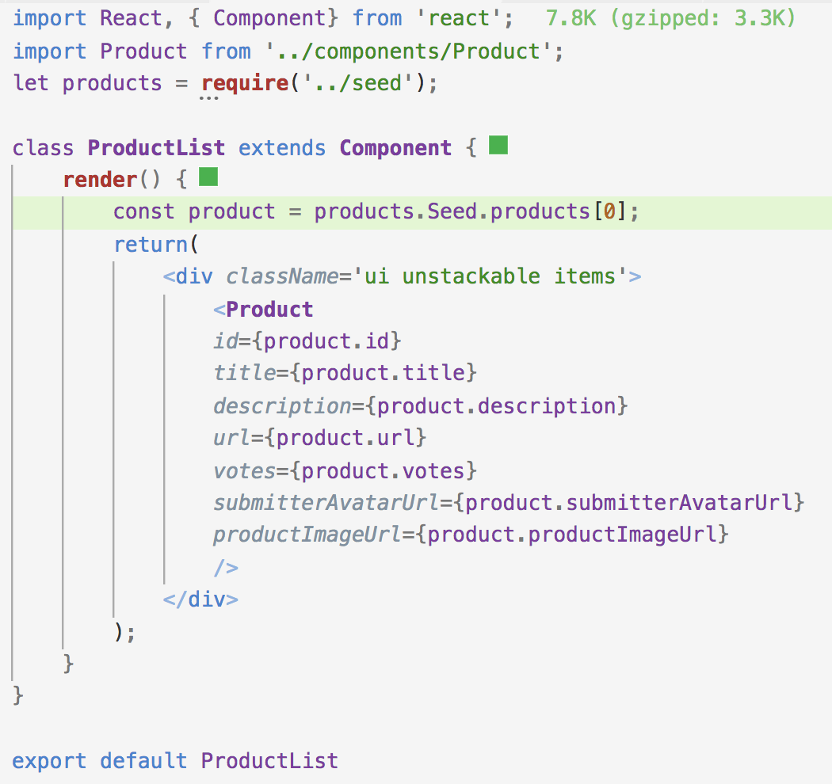
src/components/ProductList.jsx:

Slide 12
Let’s start building our component:
Let’s start building our Product component inside components folder.
Product.jsx

Slide 13
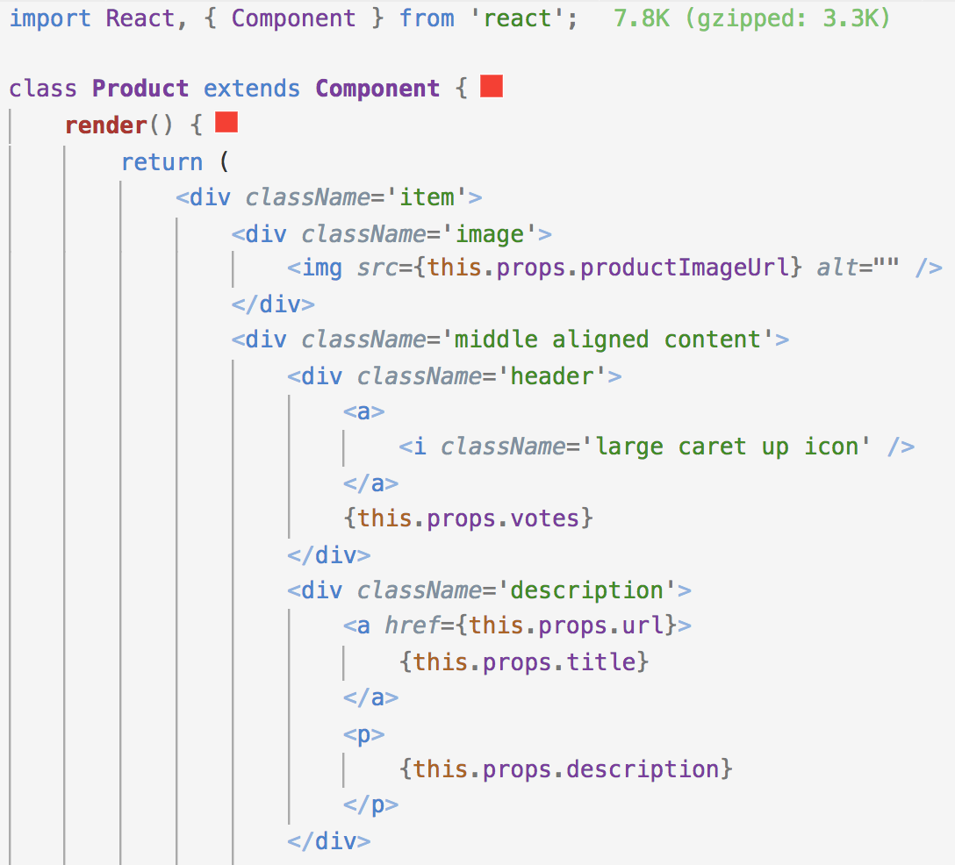
src/components/Product.jsx:

Slide 14
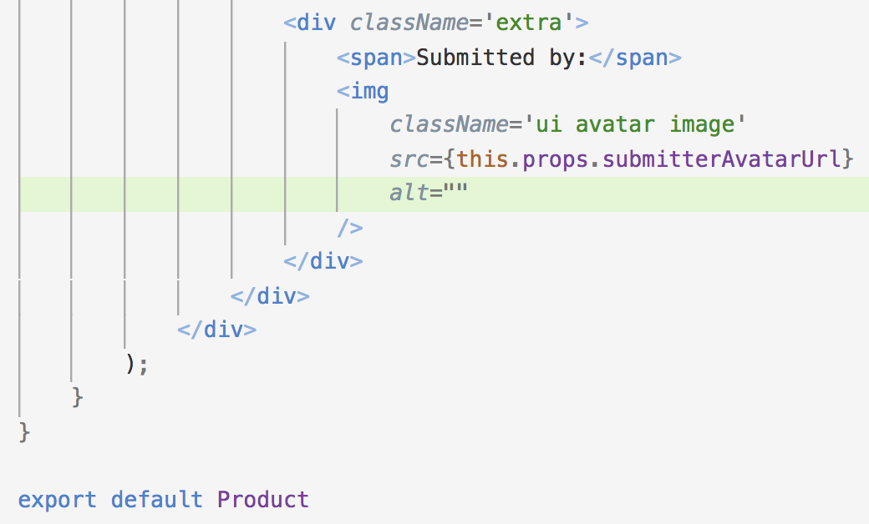
src/components/Product.jsx:

Slide 15
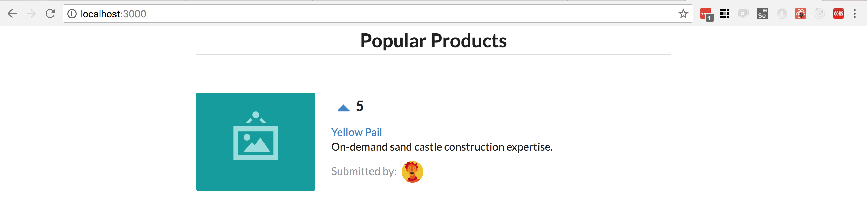
Page:

Slide 16
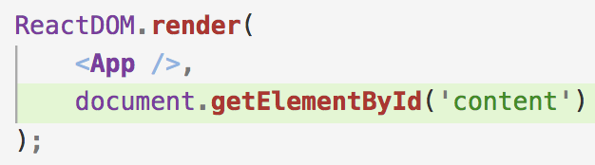
Review:
We created 2 components ProductList and Product
From index.js we imported and called the <App /> Component through ReactDOM.

Slide 17
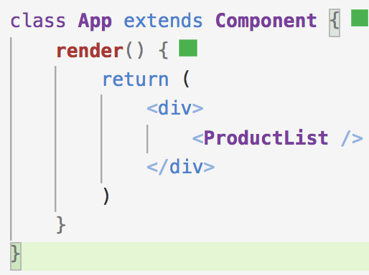
Review:
From our App component we imported and rendered our <ProductList /> component.

Slide 18
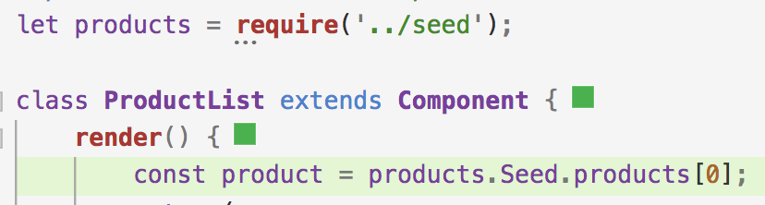
Review:
From ProductList we imported and rendered Product component.
We required a seed and got one to be rendered to a product
We passed a props from the parent component (ProductList) to the child component (Product)

Slide 19
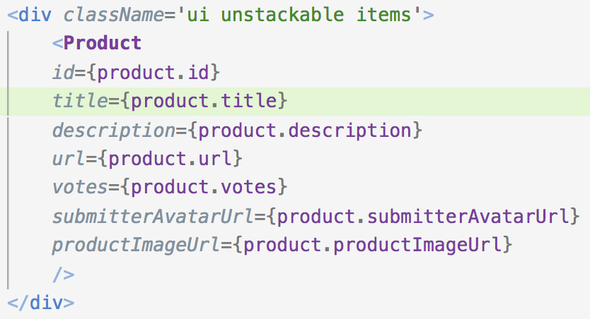
Review:
The product component with data

Slide 20
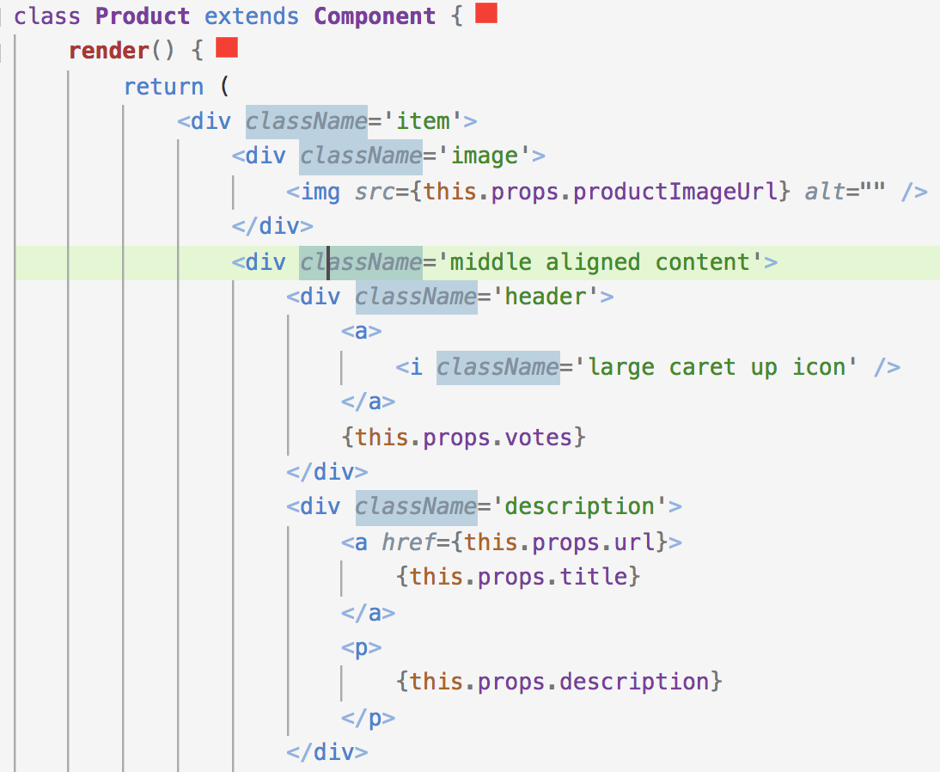
Review:
We called the data from props.

Slide 21
Rendering multiple products:
To render multiple products, we’ll have ProductList generate an array of Product components.
Each will be derived from an individual object in Seed array.
We will use the map function to do so.

Slide 22
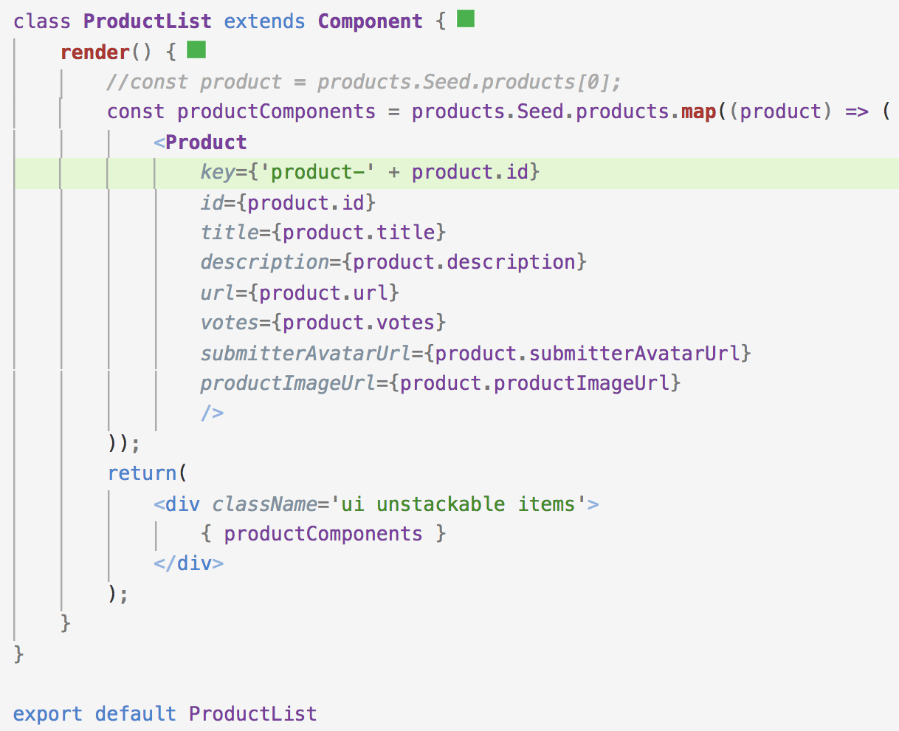
Update ProductList.jsx:

Slide 23
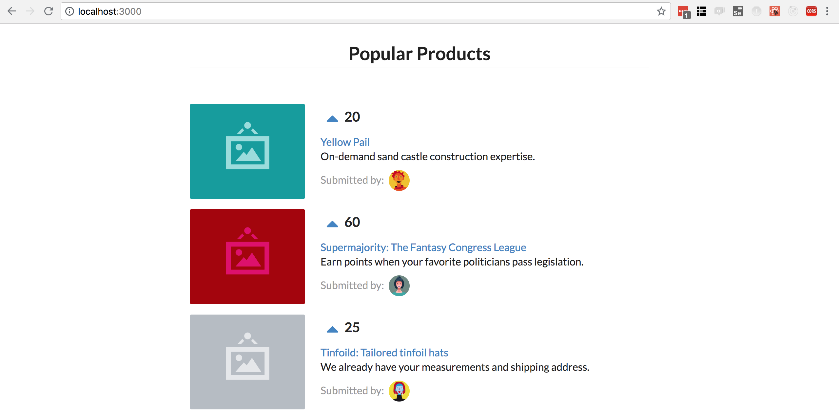
Page:

Slide 24
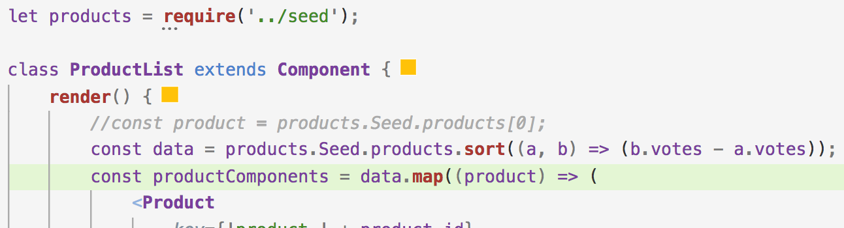
Sorting product by votes:
Use sort function on seed.
Products shall be rendered sorted by votes

Slide 25
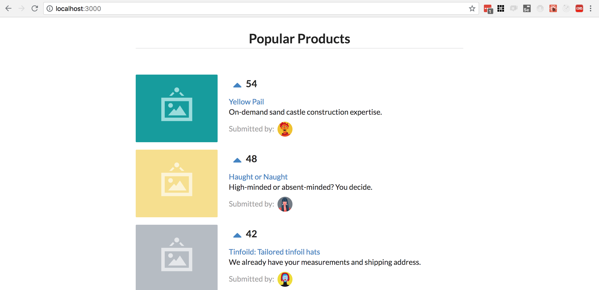
Page:

Slide 26
Working on the up-vote button:
Let’s make the up-vote button work. When clicked we expect it to update the votes attribute for that Product, increasing it by one
While the child can read its props. It can’t modify them. A child does not own its props.
The parent ProductList owns the props given to the Product.
React favors the idea of one-way data flow.
We need a way for the Product component to let ProductList know that a click on its up-vote icon occurred.
We know that parents communicate data to children through props.
Props are immutable
We can pass down functions as props too.
We can have ProductList component give each Product component a function to call when the up-vote button is clicked

Slide 27
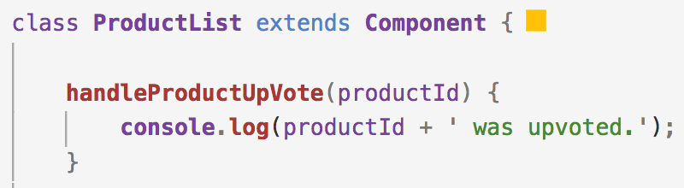
Working on the up-vote button:
Let’s see this in practice
We will have up-votes log a message to the console
Later we shall increment the votes
Let’s create a handleProductUpVote in ProductList that would accept a single argument productid.
We will need to pass this function down as a aprop to each Product component.

Slide 28
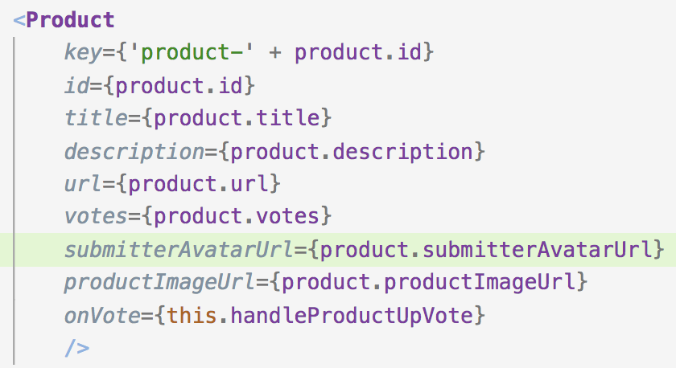
Working on the up-vote button:
We can now access this function inside Product via this.props.onVote
Let’s write a fiunction inside product that calls this new prop-function
We will name it handleUpVote()

Slide 29
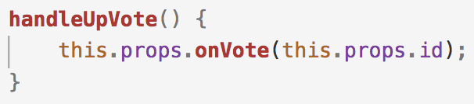
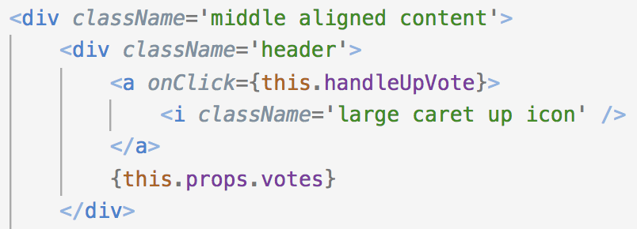
Working on the up-vote button:
In Products.jsx component
We invoke the prop-function this.props.onVote with the id of the product.
We call this function every time the user clicks the up-Vote caret icon.
In React we call the special attribute onClick to handle mouse click events.

Slide 30
App process:
User clicks the up-Vote icon
React invokes component’s handleUpVote
handleUpVote invokes its prop onVote inside the ProductList and logs a message to the conosole.
Refer handleUpVote() to this.props

Slide 31
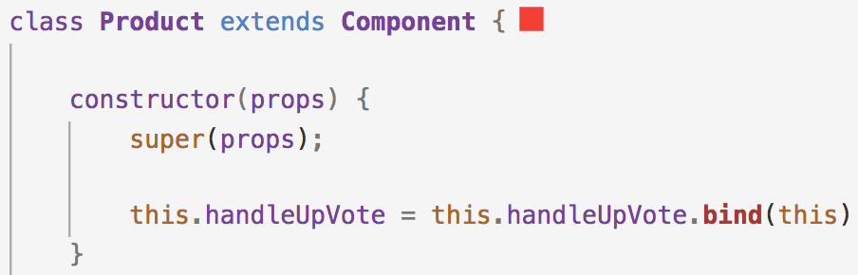
Bind custom component methods:
Inside render() this is “bound” to the component
We want this inside handleUpVote() to reference the component
React binds this to the component for us
Anytime we define our own custom component methods, we have to manually bind this to the component ourselves.

Slide 32

Bind custom component methods:
Inside render() this is “bound” to the component
We want this inside handleUpVote() to reference the component
React binds this to the component for us
Anytime we define our own custom component methods, we have to manually bind this to the component ourselves.
Test the app and click the upvote caret and look at the console.

Slide 33
State:
The events are being propagated to the parent
ProductList is the owner of the product data.
Product is now informing its parent whenever a user up-votes a product
But where do we perform this update? At the moment we don’t have a place to store and manage data. We don’t have our datastore.
We are missing a state.
When we update the seed directly React app wont be informed of the change.
In the UI side there would be no indication that a vote count was incremented.

Slide 34
Using State:
Whereas props are immutable and owned by a components parent.
State is owned by the component.
this.state is private to the component
It can be updated by this.setState()
When the state or props of a component update, the component will re-render itself
Let us move products data from Seed inside render() to the components state.
We first need to define the initial state.
Since constructor() is called when initializing our component it is best to define state there

Slide 35
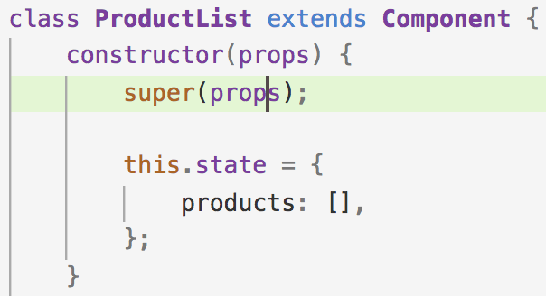
Using State:
We initialize our state to an object with an empty products array.
Add this to constructor() in ProductList
Let us modify ProductList components render function so that it uses the state as opposed from reading from Seed.
We read the state with this.state

Slide 36
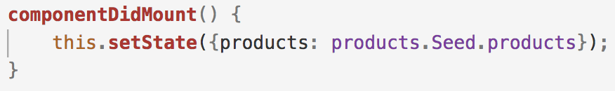
Set the State:
It is good practice to initialize components with empty state.
We would want to seed the state for ProductList with data in seed.
React specifies a set of lifecycle methods.
componentDidMount() runs after our component mounted to the page
For all state modifications after the initial state, React provides components the method this.setState()

Slide 37
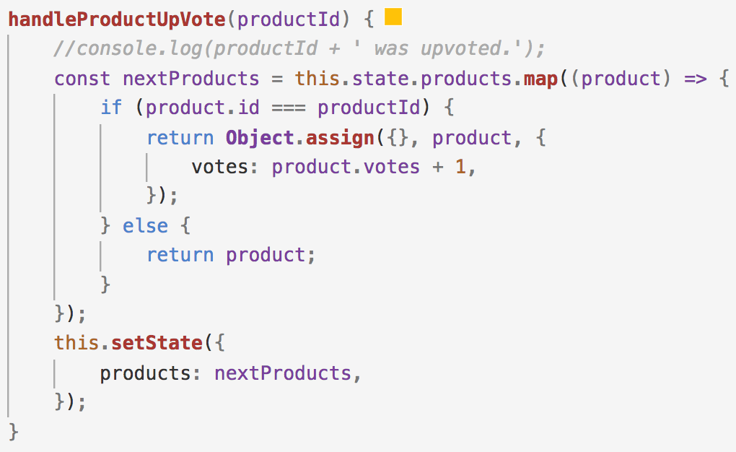
Updating states and immutability:
We need to create a new array of products.
We should modify a clone of the object as oppose to the original one.

Slide 38
Updating states and immutability:
We used .map() to traverse the products array
Map() returns a new array as opposed to modifying the array this.state.products
We check if the current product matches productid.
If it does we create a new object, copying over the properties from the original object .
We then overwrite the votes property on our new product object.
We set it to the incremented vote count.
We do this using Object’s assign() method.
If the current product is not the one specified by the productid we return it unmodified.
Finally we use setState() to update state.

Slide 39
Updating states and immutability:
Our state update for up-votes is in place
Our custom component method handleProductUpVote() is now referencing this, we need to add a bind().
Refresh application and see it work

Slide 40
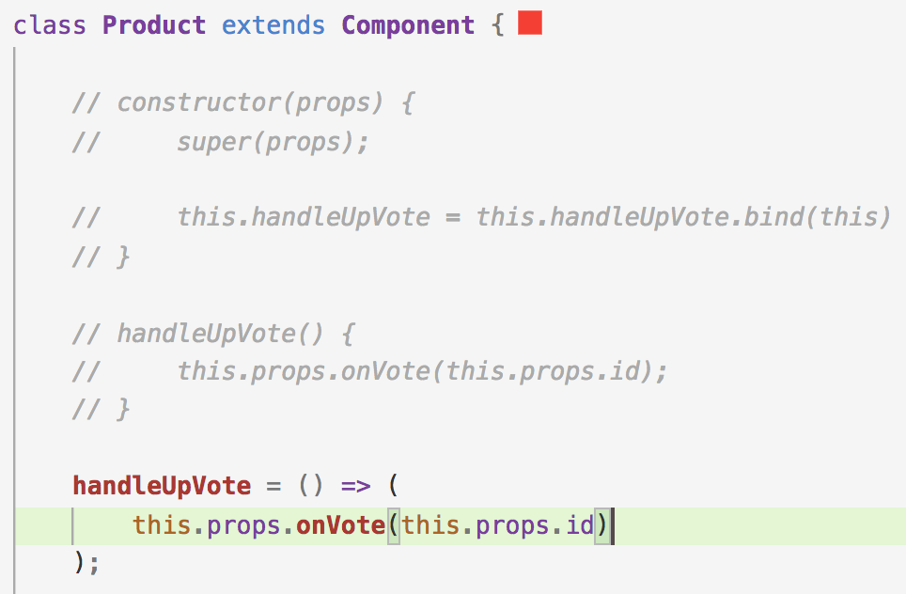
Refactoring():
Because handle handleUpVote is not part of the standard React component API, react does not bind this inside the method to our component.
That is the reason why we had to perform a manual binding trick inside constructor.
We can write handleUpVote as an arrow function. This will ensure this inside the function is bound to the component.

Slide 41
Refactoring:
Using this feature, we can drop constructor().
There is no need for the manual binding call
We can give the same treatment to handleProductUpVote inside ProductList.
Property initializers give us an alternative way to define the initial state of a component
We can use property initializers to reactor our React components
We can use arrow functions for custom component methods (to avoid bind)
We can define the initial state outside the constructor().

Slide 42
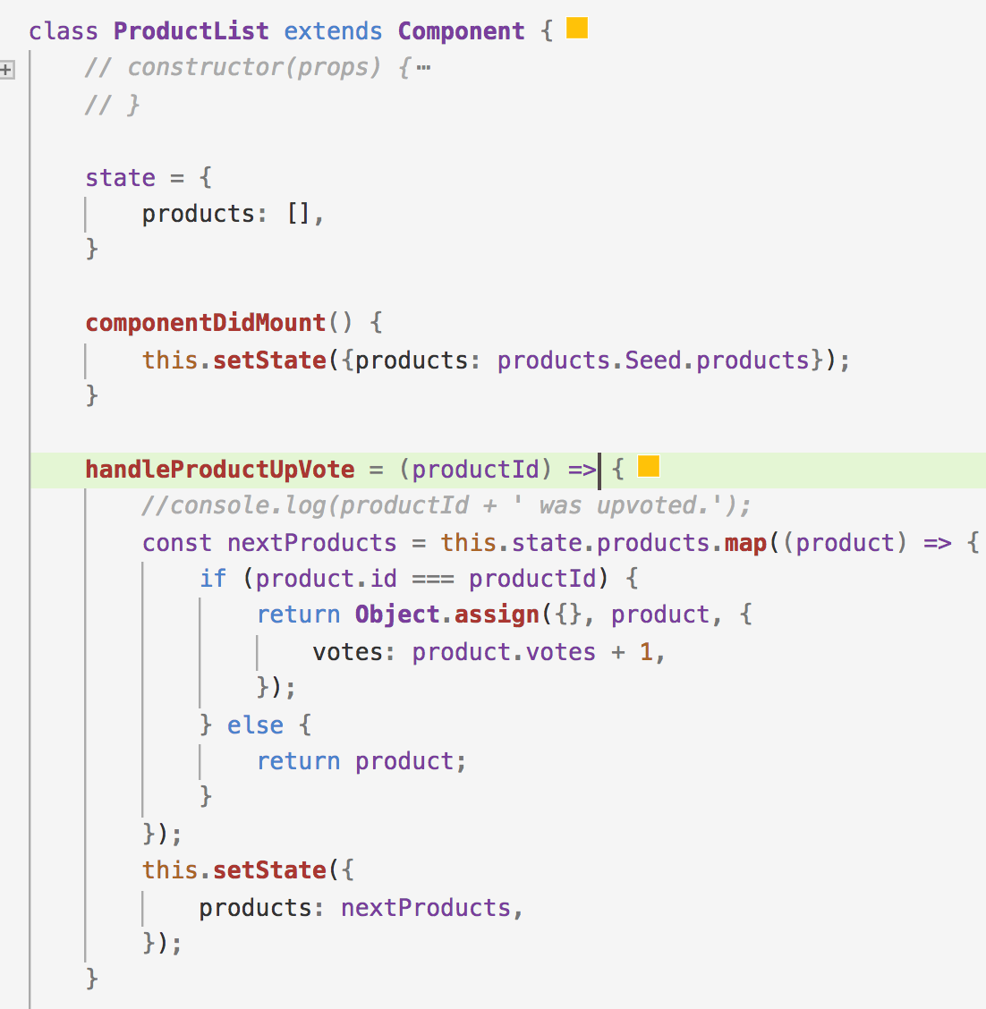
Refactoring:

Slide 43
Summary:
We taught as to how to organize our React app and components
Used JSX inside the render method
Data flows from parent to child through props
Event flows from children to parent through functions
Utilizing React lifecycle methods
Stateful components and how state is different from props
How to manipulate state while treating it as immutable

Slide 44
End of Chapter 5
y
yyyyyyyy

